Slide 1

Exploratory Data Analysis (EDA)

Slide 2
About me
Background
Background on M.Sc. Data Science.
Why you want to learn Data Science
I love to be able to solve problems by processing, analyzing, and better understanding data.
Its Most Demand, Growth, Job Security, Opportunity, Flexibility for current Information Technology field.
Any work experience
Company Name : MENMOZHI TECHONOLOGIES, Tiruchirappalli [Data Science Intern]
Project Description:
Introducing to innovative voice assistant for jewelry shops.
Our voice assistant for jewelry shops aims to achieve seamless customer interaction by integrating wake word detection, facial recognition, and real-time information delivery.
Algorithm used for NLP (Natural Language Processing), Wake up Word Detection, Face Detection and Recognition, Audio Processing, Speech Recognition.
Share your linkedin and github profile urls
Linkedin : http://www.linkedin.com/in/muralikumar10
Github : https://github.com/Muralikumar007

Slide 3
Agenda
Objective of the Project
Summary of the Data
Exploratory Data Analysis:
Data Cleaning Steps
Data Manipulation Steps
Univariate Analysis Steps
Bivariate Analysis Steps
Conclusion
Q&A Slide

Slide 4
Objective of the Project
Perform EDA to gain insights into the dataset, identify patterns, and understand the relationship between different variables and the target variable.
It includes, List of outliers, Estimates for parameters, Uncertainties about those estimates, List of all important factors, Optimal settings, A good predictive model

Slide 5
Summery of Data
The dataset contains information about individuals including their ID, salary, date of joining (DOJ), date of leaving (DOL), designation, job city, gender, date of birth (DOB), educational qualifications, college details, and various scores related to their education and job-related skills. Target Variable: Salary

Slide 6
Data Cleaning Steps
Handling Missing Values: Identify missing values in the dataset and decide how to handle them.
Removing Duplicates: Identify and remove duplicate records from the dataset to avoid skewing analysis results or model performance.
Standardizing Formats: Standardize formats for data fields such as dates, addresses, and names to ensure consistency and facilitate analysis.
Correcting Inaccurate Data: Identify and correct inaccuracies in the data, such as typos, incorrect values, or outliers that may be errors.
Handling Outliers: Identify outliers in the data and decide how to handle them, whether it's removing them, transforming them, or treating them separately in the analysis.

Slide 7
Data Manipulation Steps
Cleaning: This involves fixing errors or inconsistencies in the data, such as missing values, incorrect data types, or formatting issues.
Filtering: Selecting a subset of data based on certain criteria, such as selecting rows where a specific condition is met.
Sorting: Arranging the data in a specified order, typically based on the values of one or more variables.
Aggregating: Combining multiple rows of data into a single summary value, often using functions like sum, average, count, etc.
Joining/Merging: Combining data from multiple sources based on a common key or set of keys.

Slide 8
Univariate Analysis Steps
1. Boxplot for Numerical Columns (Outlier Detection):
Outliers can be identified by points that lie outside the whiskers of the boxplot.
In each subplot, the box represents the interquartile range (IQR), and the whiskers extend to 1.5 times the IQR.
Points beyond the whiskers are considered outliers.
2. Histogram with KDE for Numerical Columns (Probability and Frequency Distribution):
Histograms show the distribution of data across different bins.
Kernel Density Estimation (KDE) provides a smoothed representation of the distribution.
Skewness or symmetry in the distribution can be observed.
3. Count Plot for Categorical Columns (Frequency Distribution):
Count plots show the frequency of each category within a categorical variable.
It helps understand the distribution of categories and their relative frequencies.
Missing categories or unexpected outliers in counts might be indicative of data collection issues.

Slide 9
Bivariate Analysis Steps
1. Pair Plot (Numberical vs Numerical) :
The pair plot provides a visual representation of the relationships between pairs of numerical columns.
Along the diagonal, histograms of each numerical variable are displayed, showing their distributions.
Scatter plots show the relationships between each pair of numerical variables.
2. Bar Plot (Categorical vs. Numerical):
The bar plot shows the relationship between categorical variables (designations) and a numerical variable (salary).
Each bar represents the average salary for each designation.
By observing the bars, we can identify which designations typically have higher or lower salaries.
3. Stacked Bar Plot (Categorical vs. Categorical):
The stacked bar plot illustrates the relationship between two categorical variables (gender and employment status).
Each bar represents the count of individuals in each gender category, segmented by their employment status.
By observing the stacked bars, we can identify the distribution of employment status within each gender category.

Slide 10
Conclusion
Outliers are present in some numerical columns, which might need further investigation.
The probability and frequency distribution of numerical columns show varying distributions, indicating different data patterns. - The frequency distribution of categorical columns reveals the distribution of different categories within each column.
Pair plots illustrate relationships between numerical columns, suggesting potential correlations or trends. Bar plots show patterns between categorical and numerical columns, providing insights into how categorical variables relate to numerical ones.
Stacked bar plots reveal relationships between different categorical variables, indicating potential dependencies or associations between categories.

Slide 11
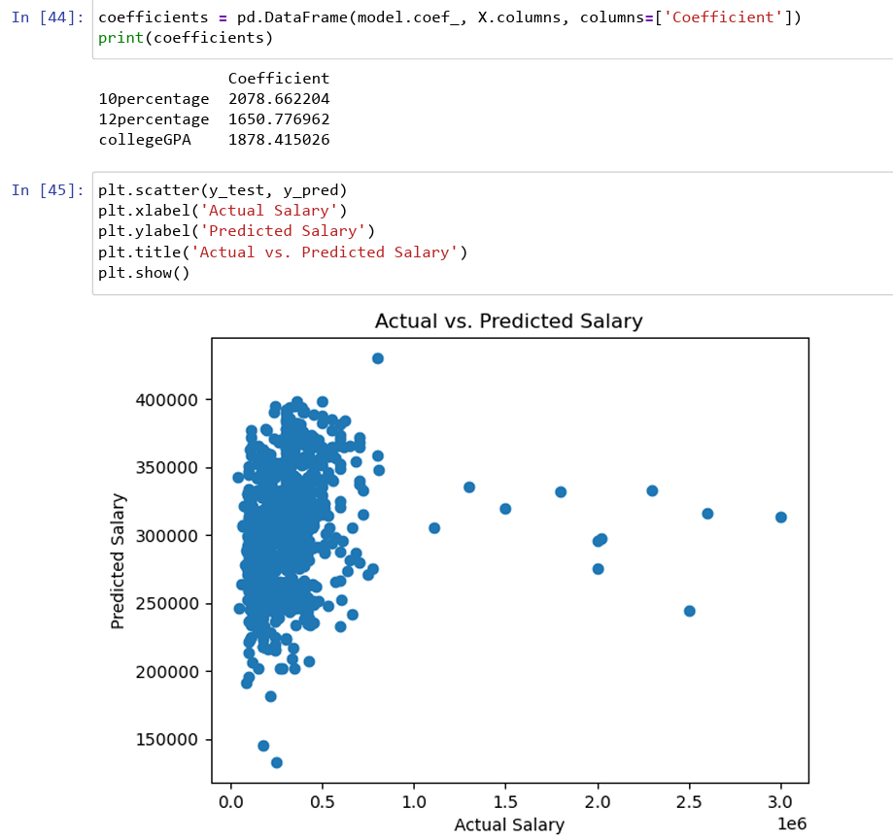
Q&A Slide
Are there any correlations between academic performance (measured by 10th and 12th percentage, GPA, etc.) and salary? Exploring the relationship between academic achievements and salary levels can provide insights into the importance of academic excellence in career success.
Solution :

Slide 12

THANK YOU

